Slide 1
5 Stage Pipelined RISC-V Processor in RTL

Slide 2
Overview
We have implementation of a 32-bit processor based on a subset of instructions from RISC-V.
The Micro-architecture contains 5 pipeline stages namely Fetch, Decode, Execute, Memory and Write back.
The processor can handle data and structural hazards with the use of forwarding and stalling logic whenever required.
The processor is implemented using Verilog HDL.

Slide 3
Why pipelining?
In single cycles processors (unpipelined) We need to wait for all individual sub-operations to complete, before we can begin processing the next instruction, we need to wait for all of these individual sub-operations to complete, before we can begin processing the next instruction.
The five stages are: (IF,ID,EX,MA,WB).
In a pipelined processor, we have divided the data path into five stages, where each stage processes a separate instruction. In the next cycle, each instruction passes on to the next stage and so on.
By doing this, we can achieve a CPI which is close to one, which is far better than an unpipelined processor.

Slide 4
Hazards due to pipeline
In fact, after a certain point, adding more stages is counterproductive. There are certain limitations for pipelined processors also, and once such limitation is Hazard. Two important types of Hazards are Data and structural hazards.
Data hazard occurs due to data dependencies and structural hazards occurs due to hardware dependencies.
To handle these hazards, one must schedule their instructions properly to avoid dependencies and also by implementing proper stalling and bypassing techniques, these hazards can be resolved.

Slide 5
RISC-V (RV32I) INSTRUCTION SET
RISC-V is an open-source instruction set architecture that defines the design of a processor. In RISC-V, the register file consists of 32 registers, each holding a fixed-size piece of data. These registers are indexed from 0 to 31. Among these, registers 1 to 31 are general-purpose registers, used for various computations and data storage. However, register 0 is a special case; it's hardwired to always contain the constant value 0, making it particularly useful for certain operations like clearing registers or initializing variables.
Additionally, the program counter is a crucial register in RISC-V that keeps track of the memory address of the next instruction to be executed. This register is user-visible, meaning it can be accessed and manipulated by the programmer.

Slide 6
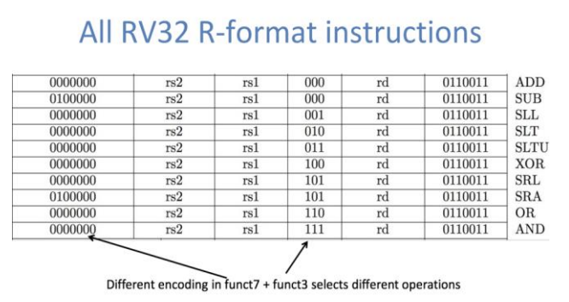
R-Format
R-format instructions are primarily used for arithmetic and logical operations, involving two source registers and one destination register.
These are register based instructions in which all three operands are registers, and are identified by the 7-bit opcode of the instruction. Some of the R format instructions include ADD, SUB, OR, XOR, AND, SRA, etc.
The different functionalities of R format instructions is identified by the function fields funct7 and funct3

Slide 7
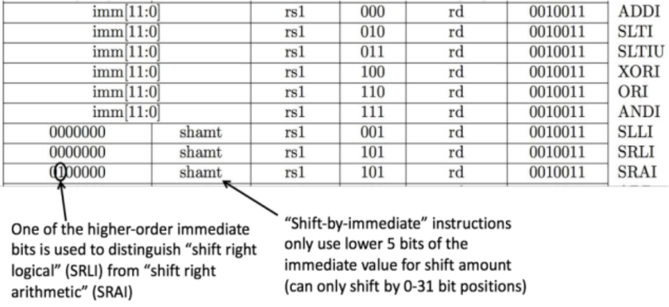
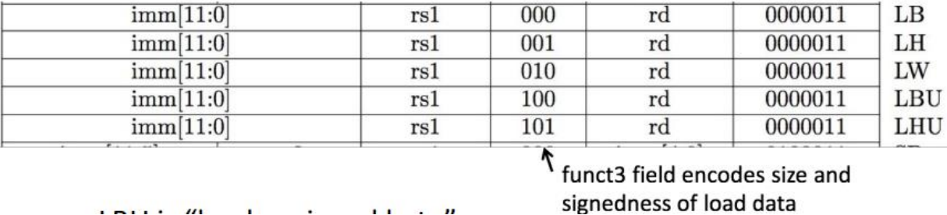
I-Format
I-format instructions handle immediate values (constants) and typically involve operations between a source register and an immediate value, storing the result in a destination register.
These are immediate type instructions, where one of the operands is an immediate bit which is directly decoded and computed from the instruction.
.
The encoding of various I format instructions. Load instructions are also comes under I format instructions whose encoding style.

Slide 8
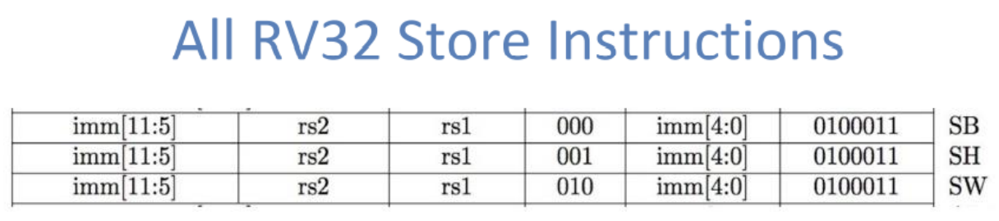
S-Format
S-format instructions are used for store operations, transferring data from a register to memory.
These are Store instructions. Store needs to read two registers, rs1 for base memory address, and rs2 for data to be stored, as well as need immediate offset. .

Slide 9
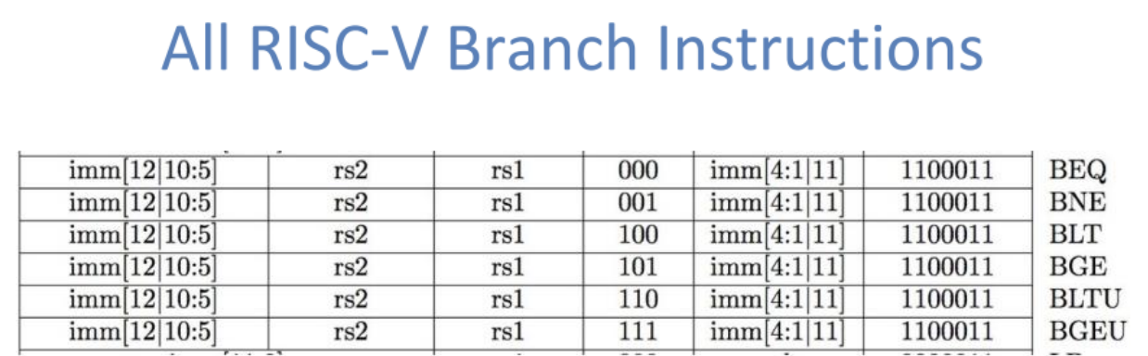
B-Format
B-format instructions manage branch operations, enabling conditional jumps based on comparisons between registers.
B-format is mostly same as S-Format, with two register sources (rs1/rs2) and a 12-bit immediate. But now immediate represents values -2^12 to +2^12-2 in 2-byte increments.
The 12 immediate bits encode even 13-bit signed byte offsets (lowest bit of offset is always zero, so no need to store it).

Slide 10
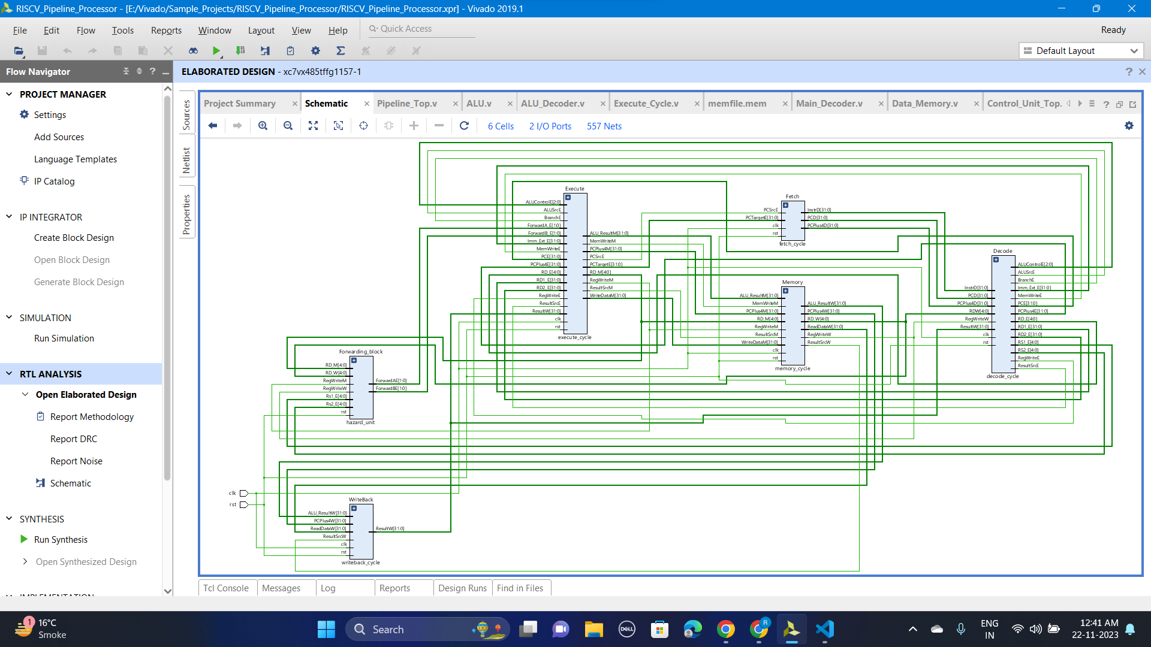
ARCHITECTURAL IMPLEMENTATION
The schematic gives an overall hardware implementation of the processor with all the units. It also has a separate Instruction memory.

Slide 11
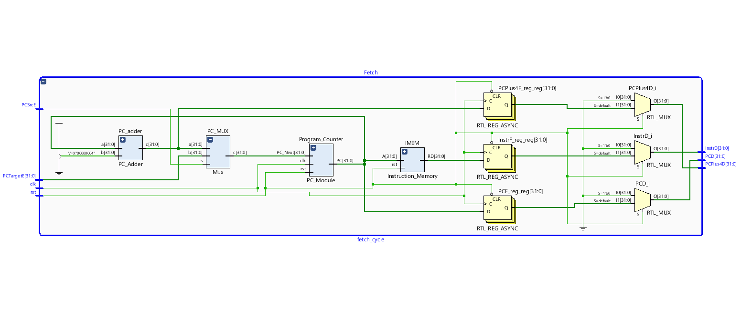
Instruction Fetch stage :
Fetches the instruction from the instruction binary specified in the instruction memory.
PC increments by 4 every time to point out to the next instruction speculatively assuming no Interrupts or exceptions occur.
It has an early decode unit which decodes the indices of the register operands and provide them to the decode stage to tells what values are to be decoded.

Slide 12
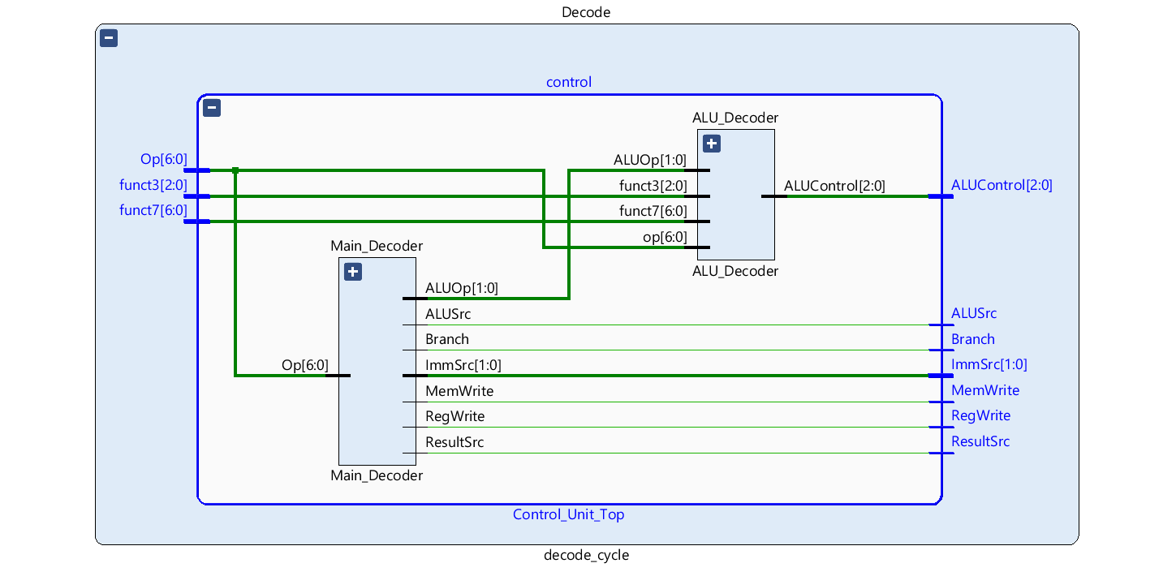
Control Unit :
The control unit generates all types of control signals that are needed by various stages at some instance.
Basically, these control signals control the data flow in the pipeline.

Slide 13
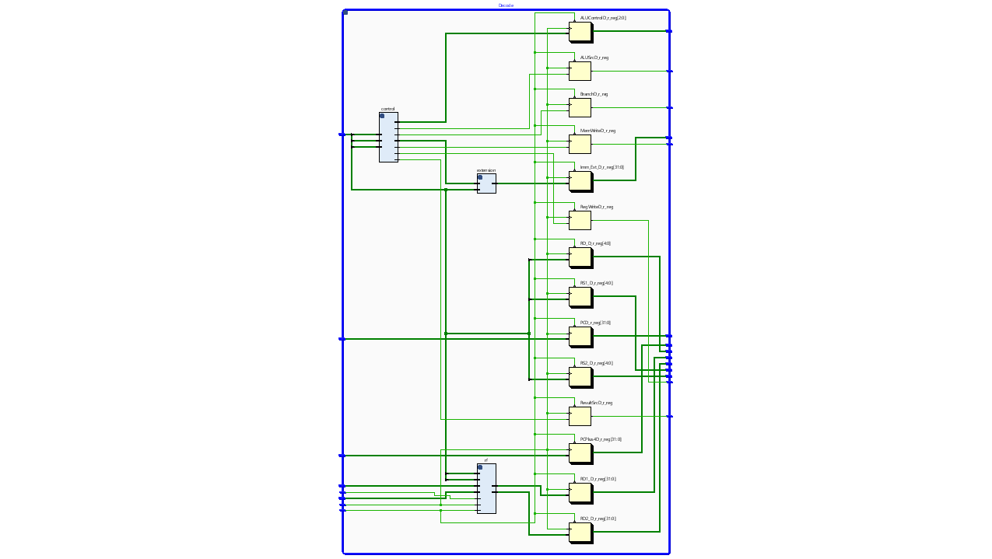
Instruction Decode Stage
Decodes the values of registers and sends it to the execution unit to perform various operations on the operands depending on the instruction.
It This stage has two sub modules namely Register file and Offset unit. Register file contains all the contents of 32 registers that are being used in the processor.
Offset has to be calculated whenever there are I, S or B type instructions, and for this purpose we have an offset unit inside the decode stage

Slide 14
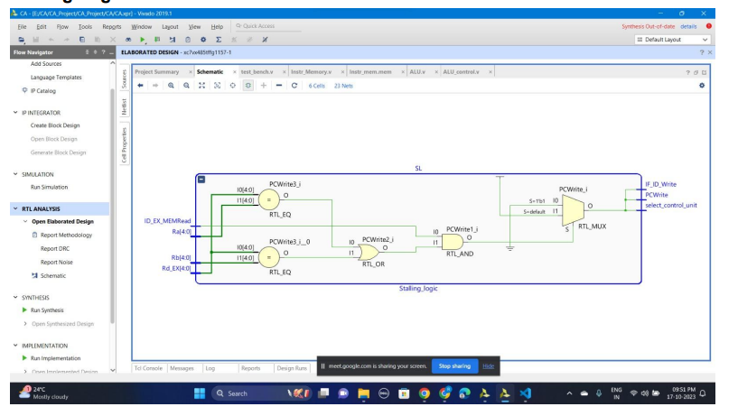
Stalling logic
Stalling is required whenever there is a structural Hazard or hardware dependency.
Stalling logic will stall the instruction at the respective stage when the next stage is busy handling the previous instruction.
The stalling logic here is implemented in such a way that if any of the source registers are being used by previous instruction, then it stalls the instruction until the register is available.

Slide 15
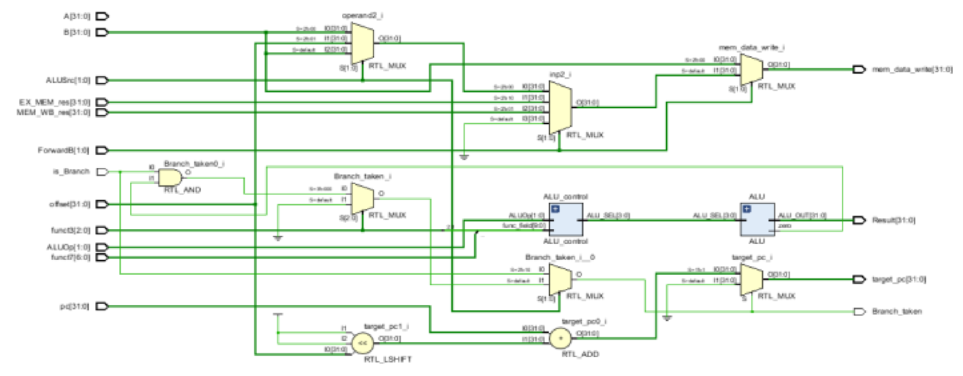
Execute Stage
This unit comprises of two sub modules –ALU and ALU Control. The logic for selection of forwarding unit is also given in the Execute unit.
The logic for branch instruction is also present in the execute unit which states whether the branch is being or not being taken and if branch is taken then the target instruction calculation is also given in the Execute Module.
ALU Control module is for selecting a particular operation out of the other operations present in ALU module. ALU module in this processor handles only R-type, I-type instruction and branch instruction.

Slide 16

Forwarding unit
A separate forwarding unit holds the bypassing logic in case occurrence of data hazards.
It forwards the results of ALU operations back to execute stage to resolve data dependencies and avoid stalling

Slide 17
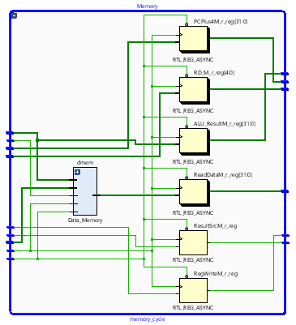
Memory Stage
Memory stage is responsible for performing all types of memory operations such as Loads and stores.
It takes the offset address from Execute stage and operand values in order to perform load and store on those memory locations.
It has a sub module called load unit which is used for load instructions. A separate unit called Data memory unit is there in order to access data from the memory locations.

Slide 18
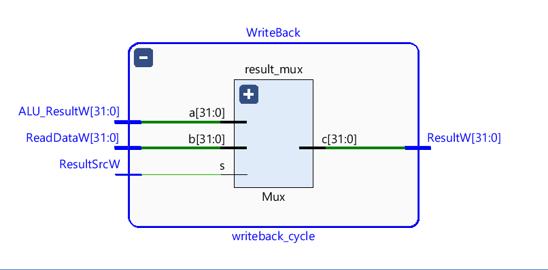
Write Back stage
The last stage is Write back stage which writes back the updated register values from the ALU result into respective registers.
The Write Back stage takes the output from the ALU or memory unit and updates the contents of the specified register with this computed result. This ensures that the processor's state accurately reflects the outcome of the instruction that has been executed.

Slide 19
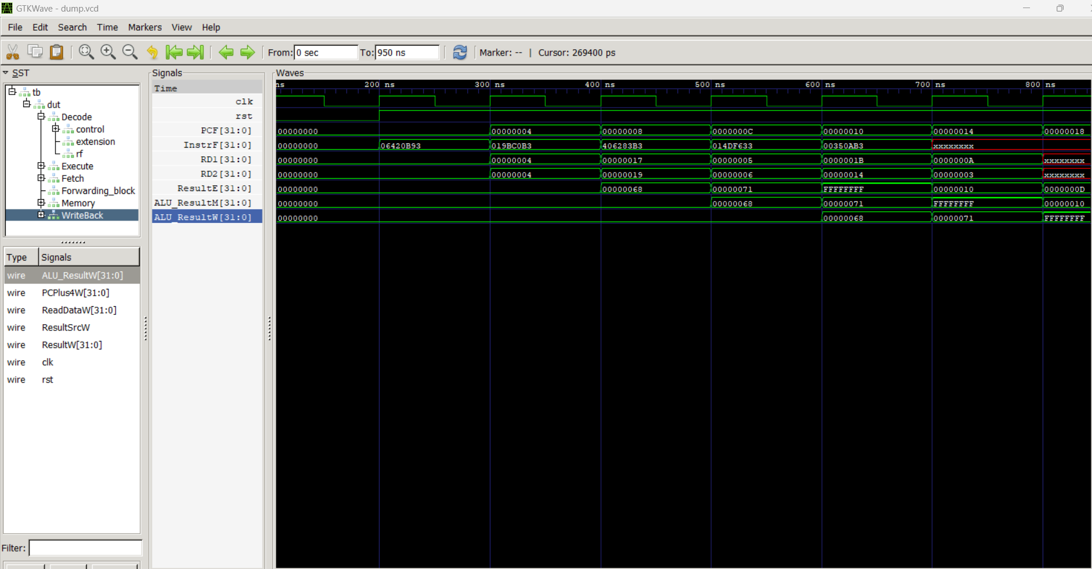
SIMULATION AND RESULTS
addi x23,x4,100
xor x1,x23,x25
sub x7,x5,x6
and x12,x27,x20
add x21,x10,x3

Slide 20
The Team
Aryan Sharma 2021025
Krishna Ayyagari 2021158
Naman Garg 2021171
Rajat Kumar 2021185
Rajat Vatwani 2021186

